Slide 1
Budget Sales Analytics
Submitted By
Betteena Thankachan

Slide 2
Table of contents
01
02
03
04
Problem statement
Data Used
Our clients
Conclusion

Slide 3
Problem Statement
Our "Domain Sale" process is structured to help potential buyers purchase the domain they want immediately without the hassle of contacting the seller directly. ... A seller lists a domain for sale at a specific price in our Marketplace. An interested buyer sees this domain for sale and decides to buy it.

Slide 4
DATA USED
Adventure works
Customer
Sales
Calendar
product
Territory
Budget sales

Slide 5
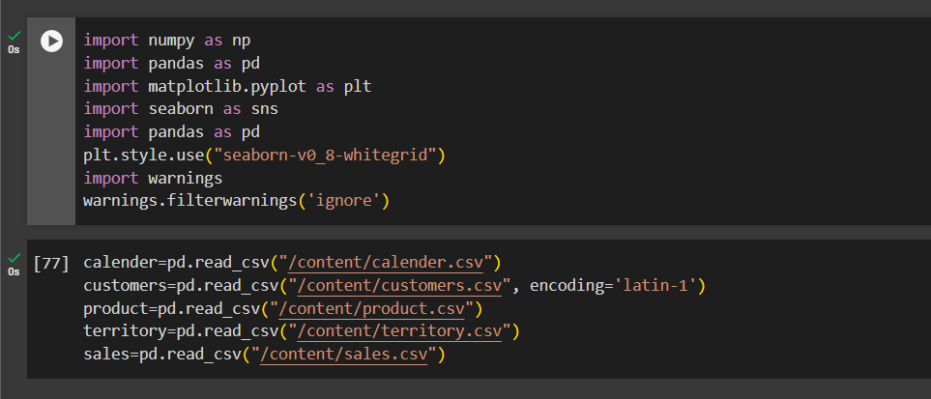
Output-PYTHON
1.Imported libraries and read the data

Slide 6
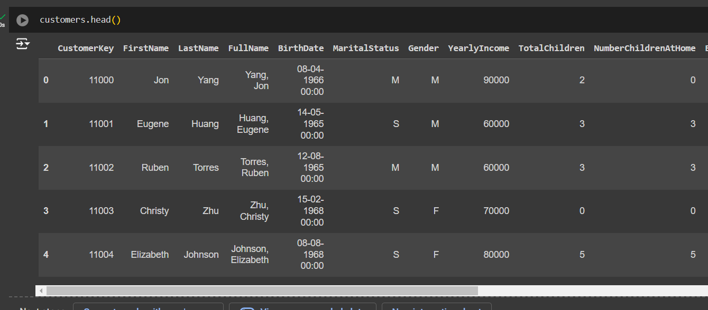
Output-PYTHON
2.Data cleaning,Data exploration for each dataset

Slide 7
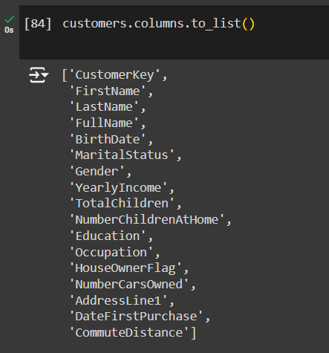
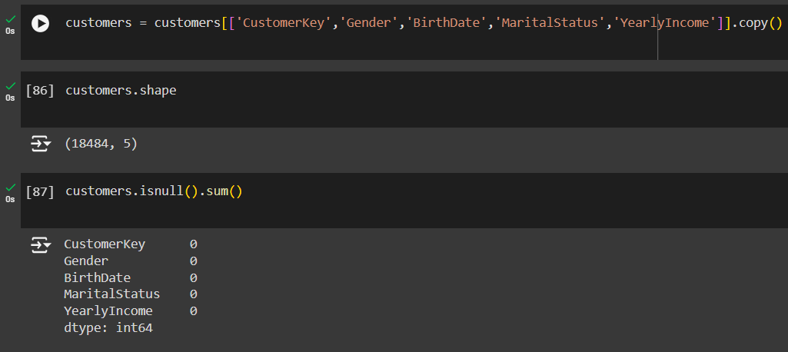
Output-PYTHON
2.Data cleaning,Data exploration for each dataset

Slide 8
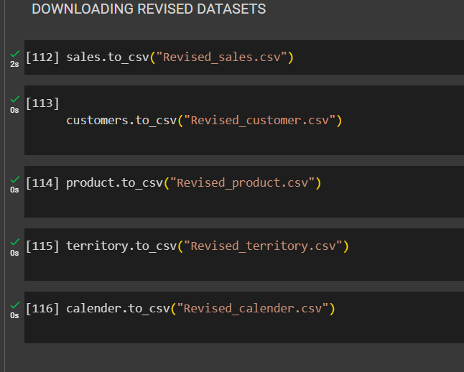
Output-PYTHON
3.Revised Data

Slide 9
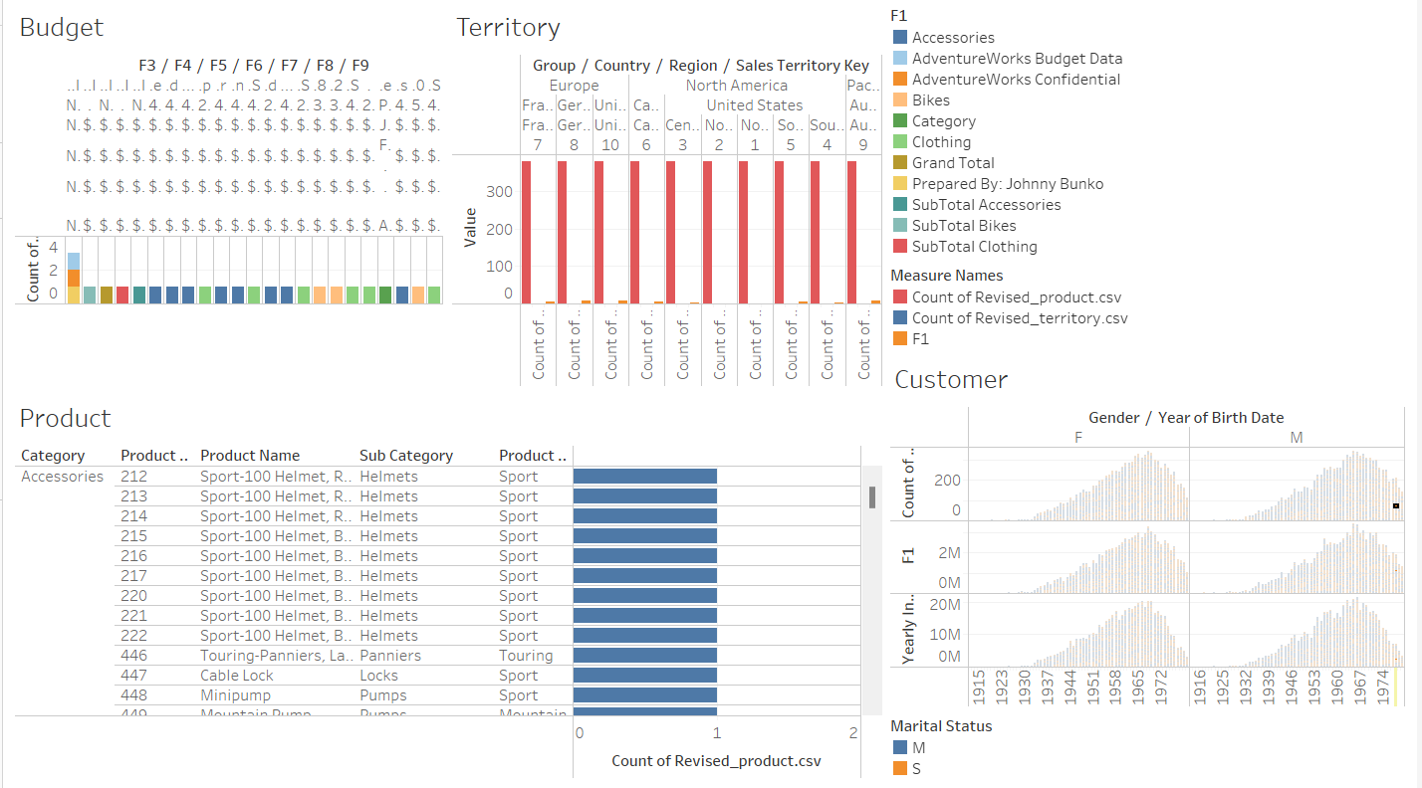
Output-Tableau
DASHBOARD-Data visualisation

Slide 10
Thank You

